Slide 1

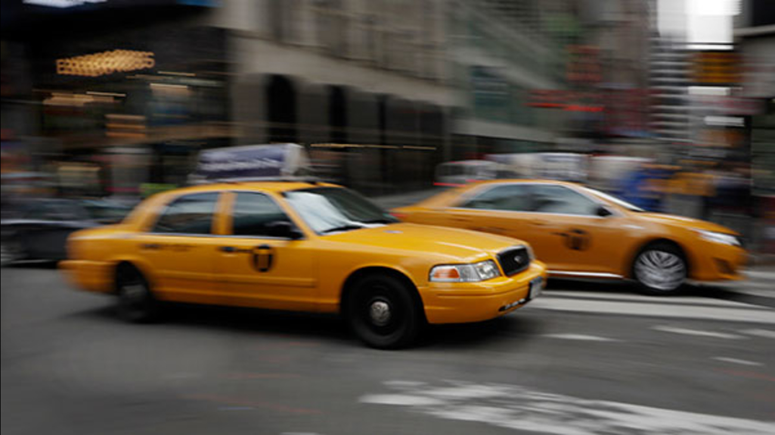

Chicago Taxi Business
Vineeth, Nilay, Rupal, and Kamil
Data Science Boot Camp
Tuesday, January 15th 2019
Weiboldt Hall, 340 E Superior St, Chicago, IL

Slide 2
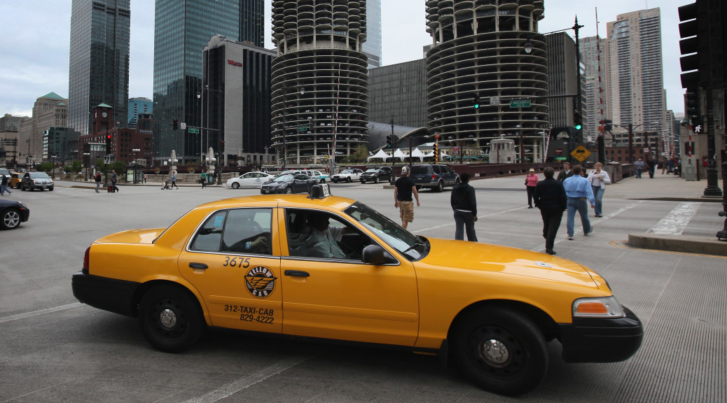
Chicago Taxi Services
Chicago residents/visitors have many options to get from point A to point B.
Our team leveraged data captured and provided by the City of Chicago to determine how taxi usage has changed over the years.
Factors that impacted the usage of Taxi Services are cost, disposable income, age range, Ride Shares via Uber, Lyft as well as Bike and Scooter Share options.

Slide 3
Data
Data Source:
City of Chicago
Taxi Usage
Census Tract
Pickup and Drop by Community Area
Income and Age factors
Data Analysis Approach
Analyzed data between January 2013 and August 2017
Trip Start Timestamp, Community Area, Census Tract, Trip identifier, Taxi identifier, Payment Type, Fare, Pickup Latitude and Longitude.

Slide 4
Taxi Usage

Slide 5
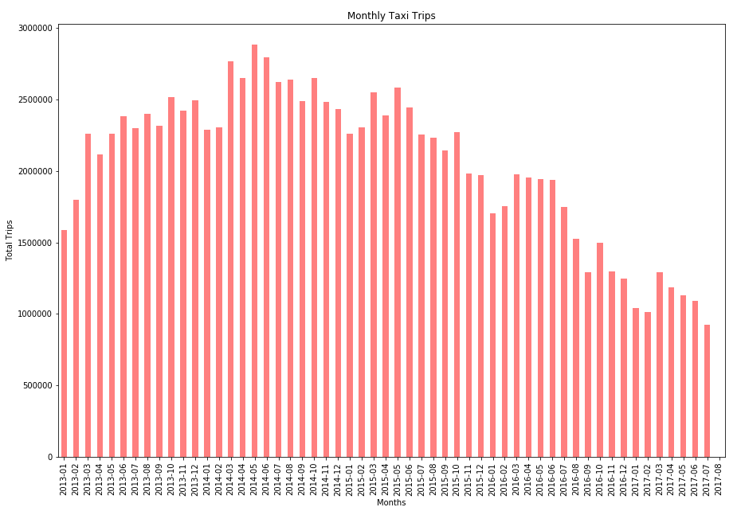
Taxi Usage over Time (Monthly)
The most interesting thing here is that from 2013-mid-2015 the number of trips were flat.
Uber launches in 2011 in Chicago. Lyft launched in 2013.

Slide 6
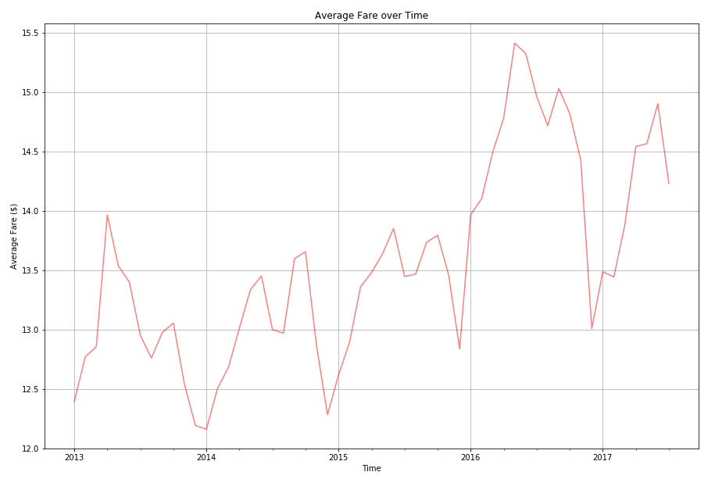
Trip Total Fare over Time
This plots the average fare per month. One of the things to notice here is the cyclicality of the average fare.
The lowest average fare occurs in the winter months, and the highest average fare occurs in the summer months. We
Notice the bump and dip from March to May. Not only is St Patrick's day the busiest in terms of number of trips, but it also carries the highest average fare.

Slide 7
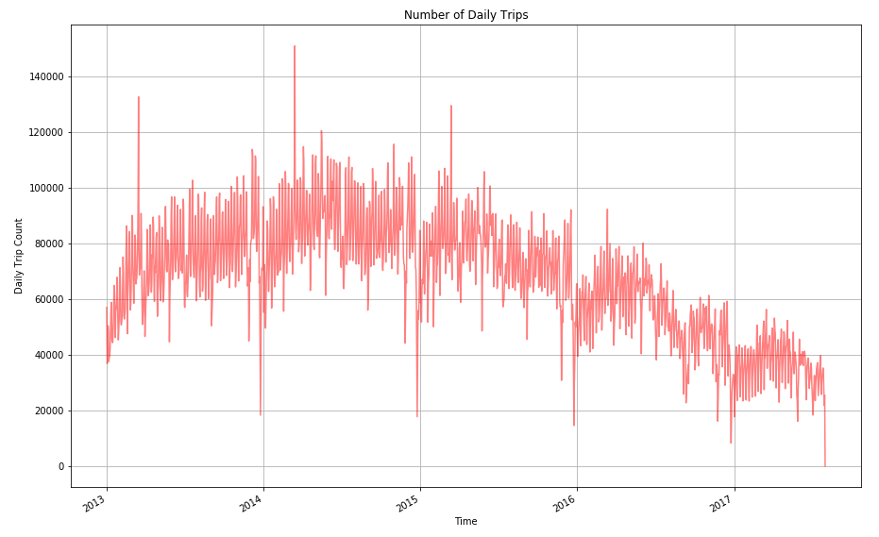
Chicago Daily Trips
??
??
Daily trip totals were analyzed between from 2013 to 2017.
The spikes appear during the first two weeks of March each year.
That increase in taxi usage occurs because of St. Patrick's day Parade; which is the busiest day for taxi cabs.
The down spikes occur on Christmas day, which is the slowest day

Slide 8
Payment Method

Slide 9
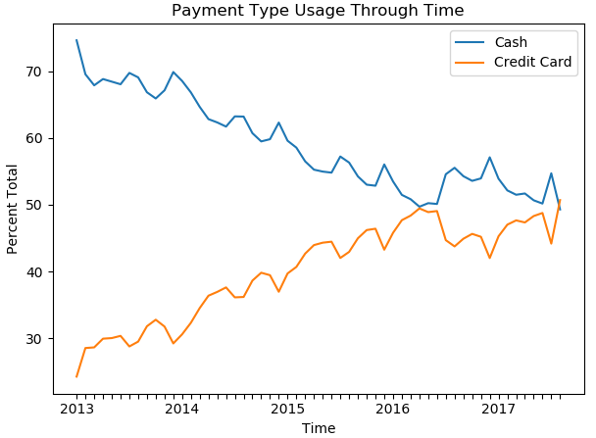
Cash vs Credit by Trip Total Fare
This shows the payment type usage over time. It is surprising that cash usage dominated between 2013-2017.
Cash usage has dropped over time and starts to plateau starting 2016.
We expect that cash usage decreases and credit card usage increases over time.
With the limited data set we cannot explain why they plateau after 2016 and how long the trend will continue.

Slide 10
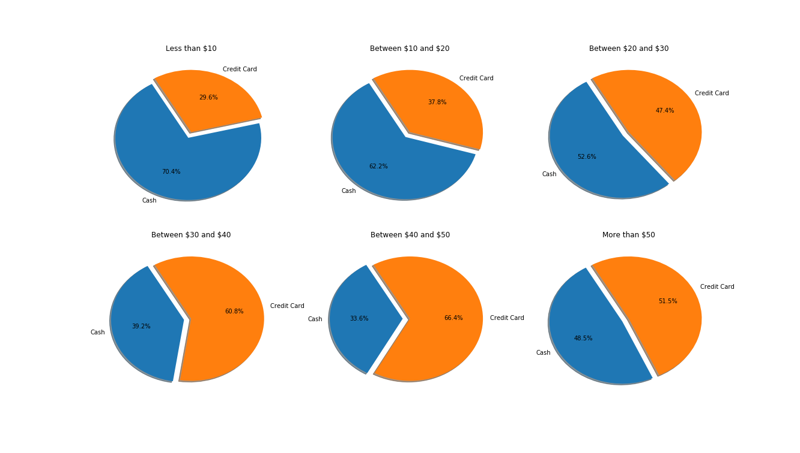
Cash vs Credit by Trip Amount
< $10
$10 - $20
$20 - $30
$30 - $40
$50 - $50
> $50
This breaks down payment type based on the fare amount and type.
As we can see for fares below $10, the vast majority of transaction as made in cash
But as we start increasing the fare, credit card usage rises.

Slide 11
Data Analyses by Community Area

Slide 12
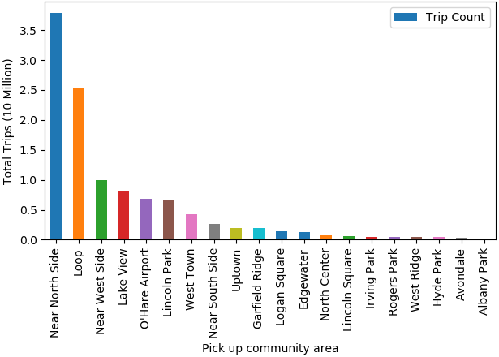
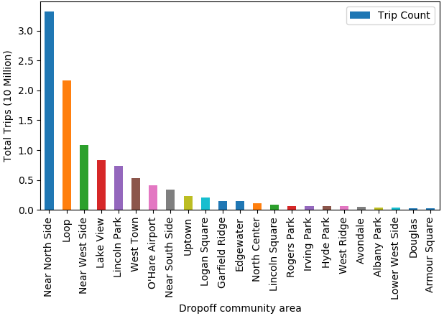
Taxi Pickups and Drop-offs
Most of the taxi riders are from Near North Side, Loop, Near West Side, Lake View, and O’Hare Airport.
There are more pickups than drop-offs within a particular community area.

Slide 13
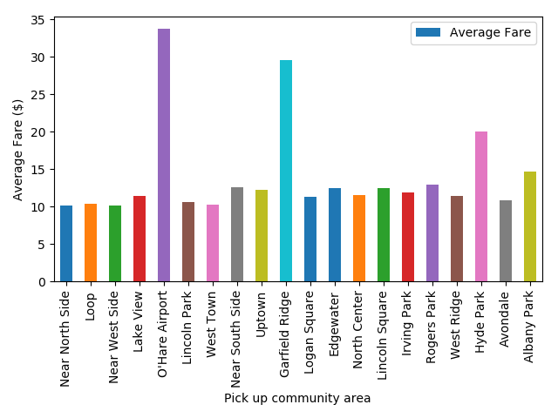
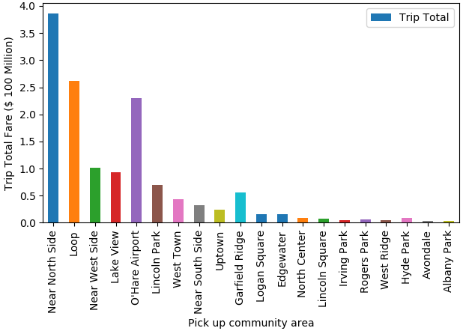
Taxi Trip Fare by Pickups
Near North Side, Loop, Near West Side, Lake View, and O’Hare are the most active areas for Taxis.
Average cost is high for taxi trips starting at O’Hare Airport, Garfield Ridge, and Hyde Park.
The trip totals from the busiest communities are still very high.

Slide 14
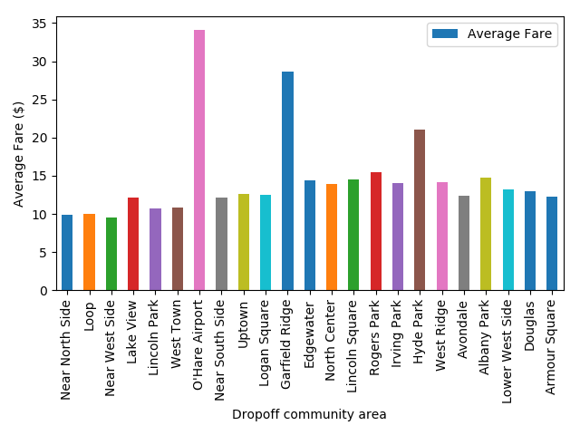
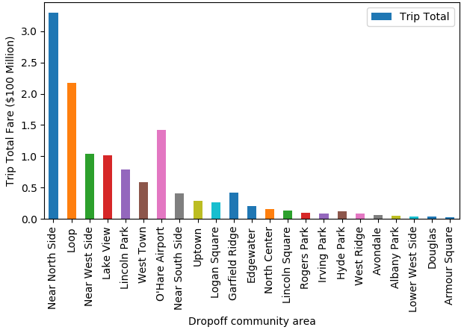
Taxi Trip Fare by Drop-offs
Near North Side, Loop, Near West Side, Lake View, and O’Hare are the most active drop-offs areas for Taxis.
Average cost is high taxi trips starting at O’Hare Airport, Garfield Ridge, and Hyde Park.
Average taxi trip is around $10 for most of the 20 busiest community areas in Chicago.
The trip totals from the busiest communities are still very high.

Slide 15
Mapping Taxi Usage

Slide 16
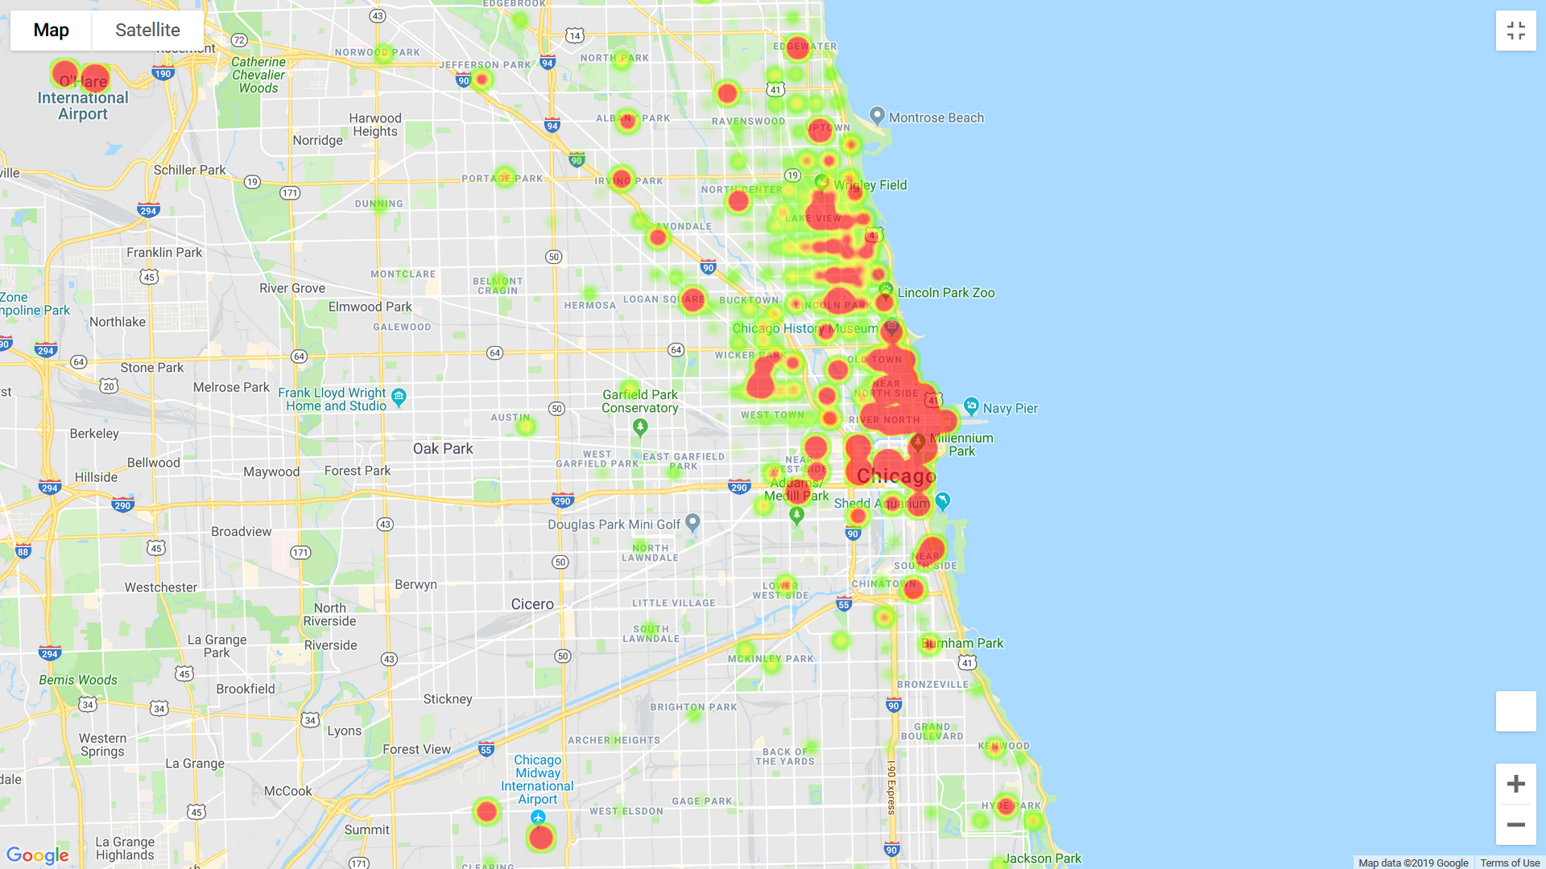
Chicago Taxi Pickups
From our Chicago Taxi Pickups Heat Maps. We can see that the busiest areas of the city for taxi pickups are located downtown, GoldCoast, and Lakeview.
There are also significant activity in taxi pick ups from the O’Hare airport and Midway airport.

Slide 17
Taxi Trip Distributions

Slide 18
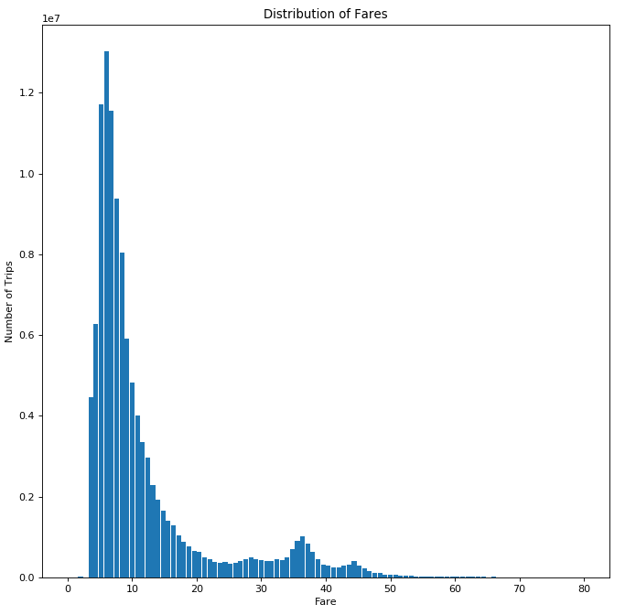
Taxi Trip Fare Distribution
This graphs shows the distribution of fares. The vast majority of fares are below $10.
We see a bump at the end over the $30-40 range, and this is the bump from trips to and from O'Hare which are one of the most expensive ones.

Slide 19
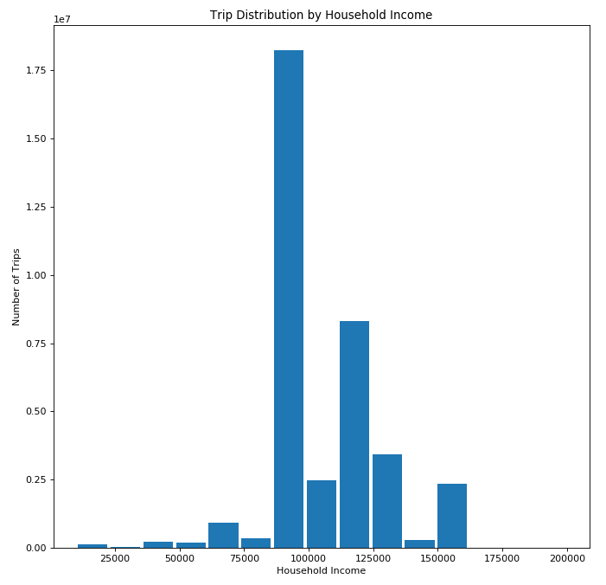
Taxi Trips by Household Income
The trip distribution based on household income of the census tract.
The maximum usage occurs in the 80-90k range, and drop-offs after that. The number of trips below the 80k range is negligible.
This shows the sweet spot for taxi usage is the upper middle classes income range, where people can afford taxi cabs

Slide 20
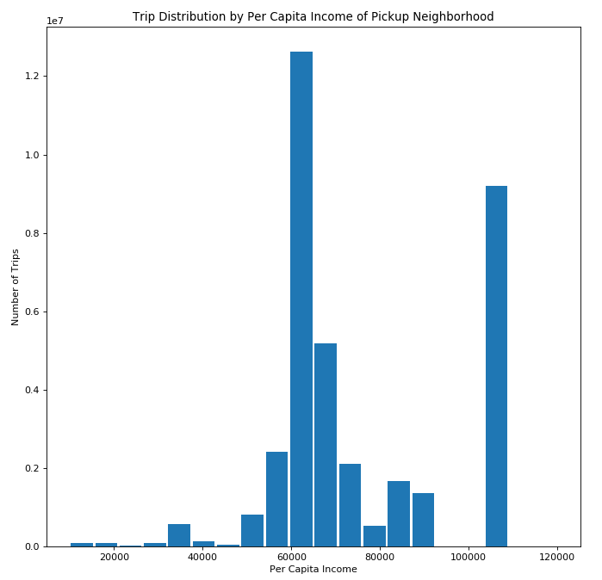
Trip Distribution by Per Capita Income
The is trip distribution based on per capita income of the census tract.
The highest is the 60k range, drops above that.
If we wanted to look for the cut-off, which is at what income level do taxi cabs become feasible, this graphs tells us that for people who make more than 60k, taxis are affordable, but below that they are too expensive.

Slide 21
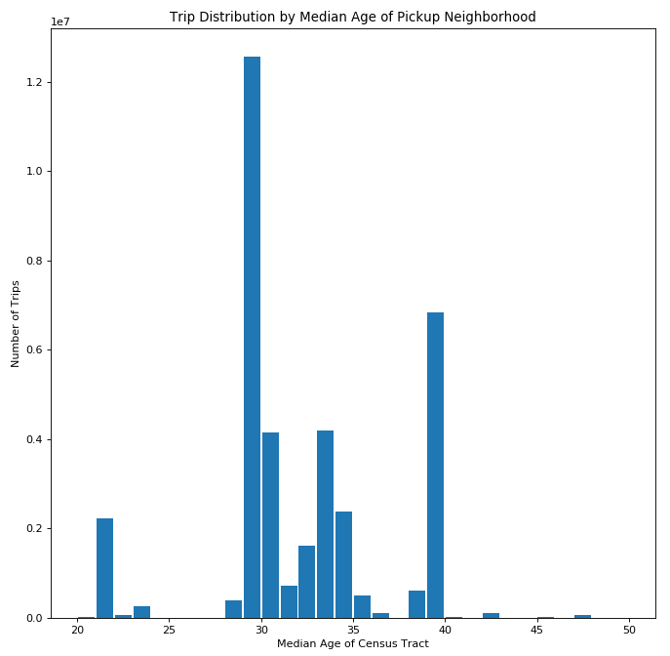
Taxi Pickups by Median Age
This graphs shows the distribution of trips based on the median age of the census tract where the pickup occurred.
What we can see is that the vast majority of trips occur in the 30-40 year old range.
After 40, they might move out of dense metropolitan areas where taxi rides are common and move to the suburbs, where they are likely to use their own vehicles for transport.

Slide 22
Conclusions
Chicago taxi data was analyzed from January 2013 - August 2017.
Chicago taxi usage has declined over time and this could be due to the rideshare options.
Riders prefer using cash over credit card for payments under $10 and most of these riders have a median age between 30-35.
There are between 20-35 million riders in Loop Near North Side and results in traffic congestions in the downtown area.
Challenges
Data for rideshare for Chicago is not available/insufficient to analyze.
The data size was 43 GB with 113 million rows and 23 columns.
Data sharing and parsing was unmanageable within the time frame.

Slide 23
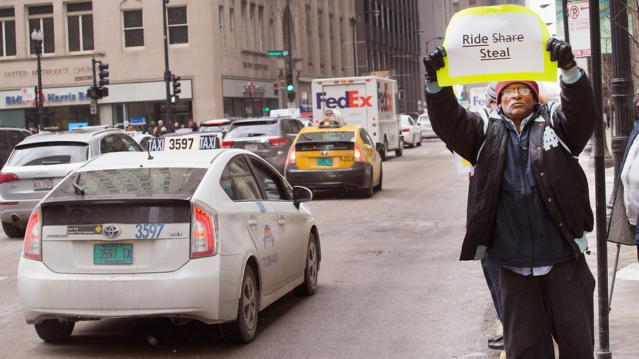
THANK YOU
Questions??

